Slide 1
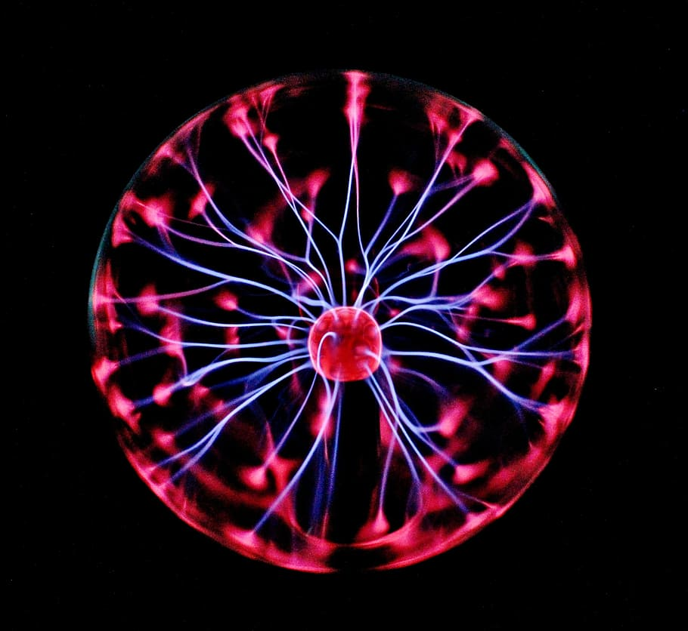



Plasma Donation System
Team Titans
Akshay
Sumit
Yashwant

Slide 2
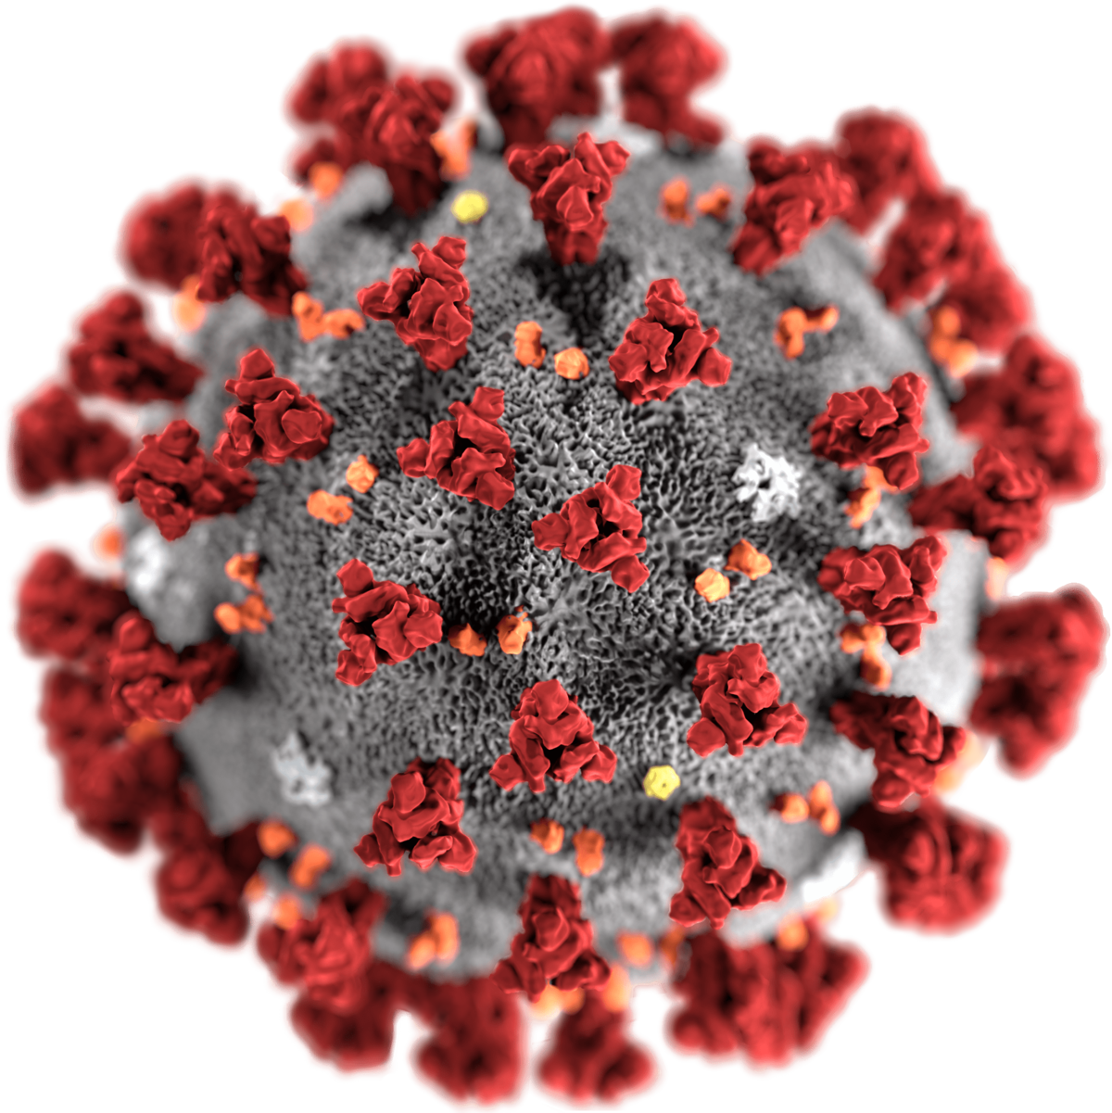
Motivation
Convalescent plasma from patients who have already recovered from coronavirus disease 2019 (COVID-19) may contain antibodies against COVID-19.
Giving this convalescent plasma to hospitalized people currently fighting COVID-19 may help them recover.
This Photo by Unknown Author is licensed under CC BY-SA

Slide 3



Problem
Demand
Platform
Trust

Slide 4



Solution
Titan’s System
Trust
A platform which takes care of all the aspects of Convalescent Plasma donation and distribution
Financial
Ecosystem

Slide 5




Approach
The Donor can voluntarily register on the platform!
Plasma Bank takes care of the Plasma Availability
Legal Authority takes Consent for the Plasma Therapy

Slide 6
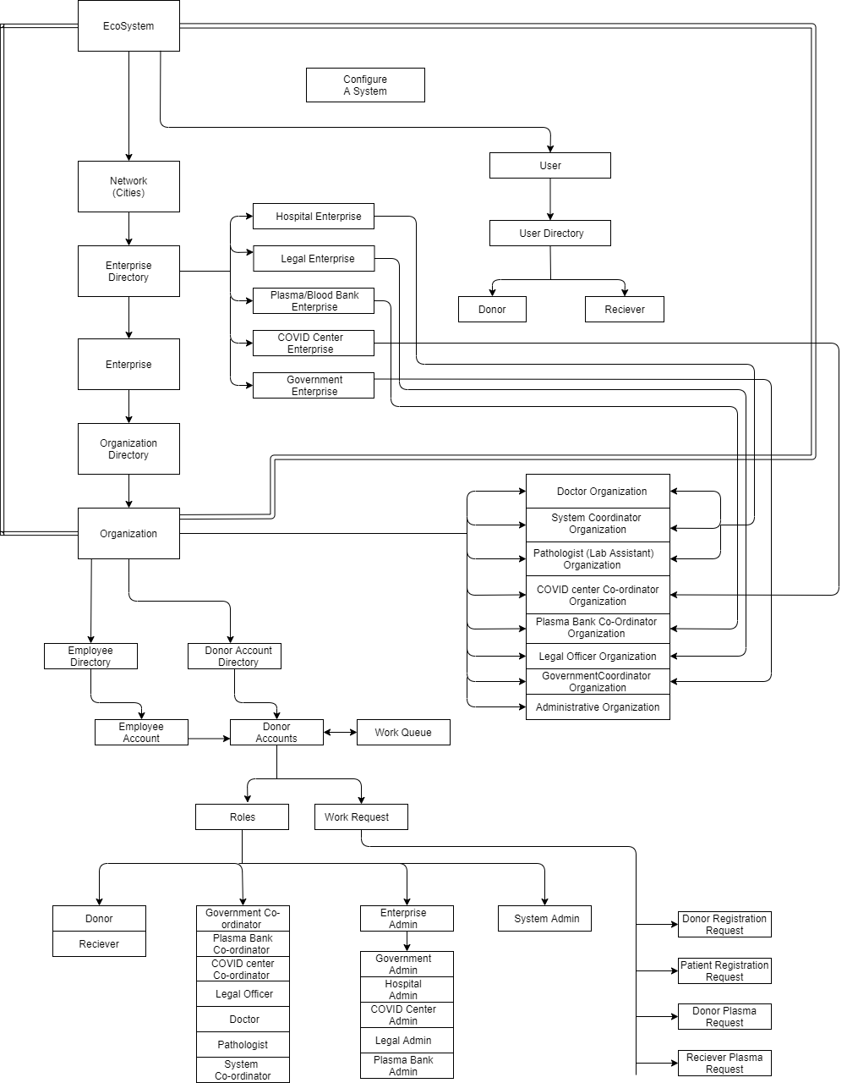
Object Model

Slide 7
Work Request Flow

Slide 8
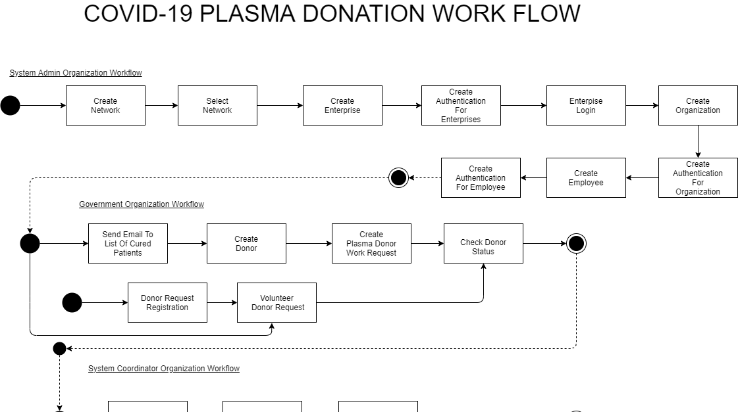

Slide 9
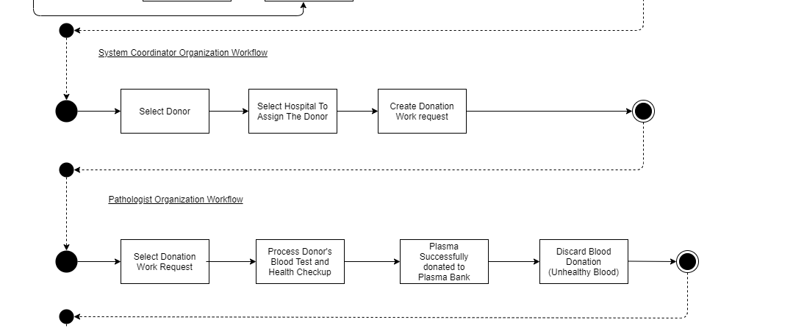

Slide 10
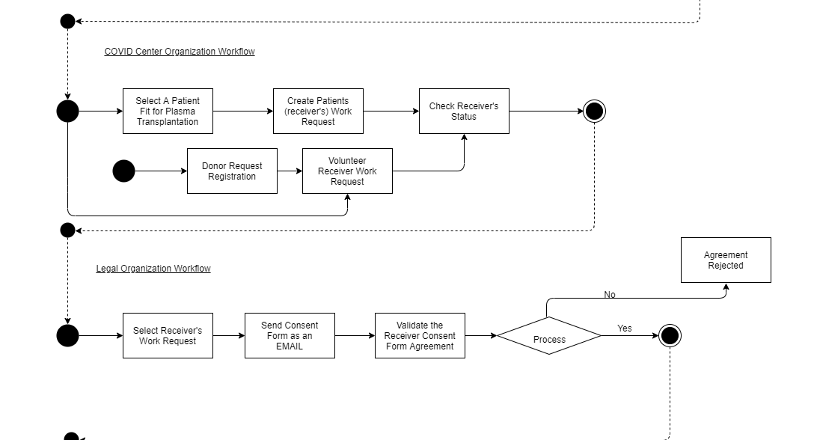

Slide 11
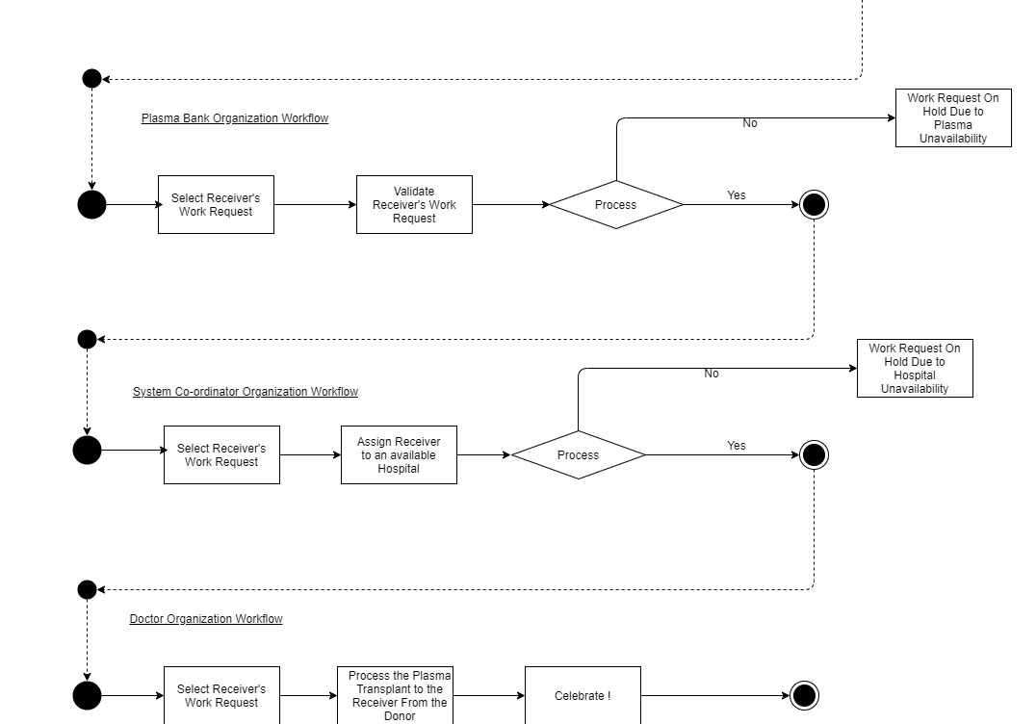

Slide 12
Screenshots

Slide 13
Statistics
Item 1
Item 2
39
4
29
27
4
5
20
35
5
Record the information you get from your experiment
25
22
15
10min
20min
30min
40min
Include a table or graph to display what you see

Slide 14

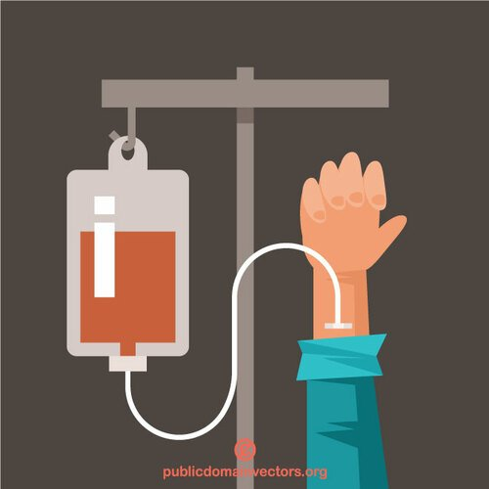

dgsd
dgsdgsdgdgd

Slide 15
Conclusion

Slide 16
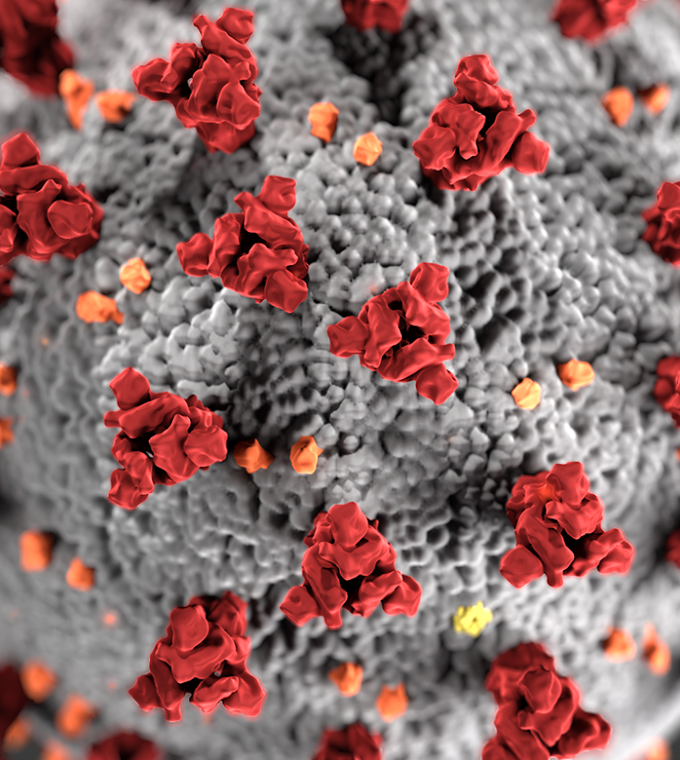
Thank you

